Slide 1
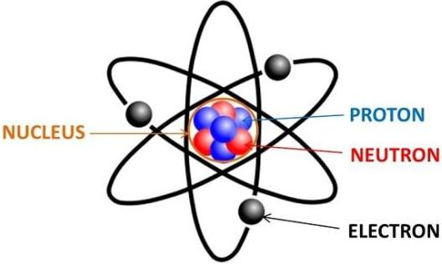
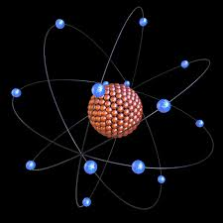
Unit-I
Atomic and molecular structure

Slide 2
Introduction
An atom is present at the most basic level in everything we see around us.
In fact, every living organism and non-living thing is composed of atoms.
So the building blocks of matter are atoms.
A smallest unit of element which consists of a dense, central positively charged nucleus surrounded by negatively charged electrons is called as atom.

Slide 3
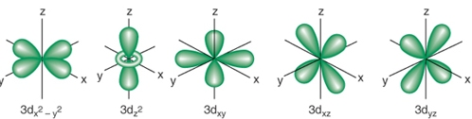
Atomic orbitals
The region just outside the nucleus, where the probability of finding an electrons is at the highest (95%) is orbital.
d-orbital

Slide 4
Molecular orbital theory
MO theory was originally called the Hund-Mulliken theory.
Atomic orbitals of comparable energy and proper symmetry combine together to form molecular orbitals.
The movement of electrons in a molecular orbital is influenced by all the nuclei of combining atoms. (Molecular orbital is poly centric in nature).
The number of molecular orbitals formed is equal to the number of combining atomic orbitals.
When two atomic orbitals (AO's) combine together two molecular orbitals (MO's) are formed.
Molecular orbitals are
Bonding MO
Ant bonding MO.
Non bonding MO

Slide 5
The molecular orbital having higher energy than corresponding atomic orbital are antibonding molecular orbital (ABMO) produce by destructive overlapping of AO.
The molecular orbital having lower energy than corresponding atomic orbital are bonding molecular orbitals (BMO) produce by constructive overlapping of AO.
The atoms with odd number or different energy of AO form non-bonding MO. NBMO is a molecular orbital whose occupation by electrons neither increases nor decreases the bond order.
In molecules electrons are present in molecular orbitals. The electron filling is in accordance with Pauli's exclusion principle, Aufbau principle and Hund's rule.

Slide 6
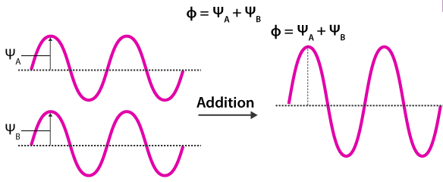
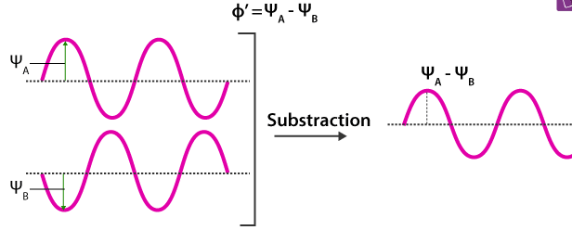
Equations for atomic and molecular Orbitals
An atomic orbital is an electron wave; the waves of the two atomic orbitals may be in phase or out of phase. Suppose Ψ_{A} and Ψ_{B} represent the amplitude of the electron wave of the atomic orbitals of the two atoms A and B.
Case 1: When the two waves are in phase so that they add up and the amplitude of the wave is Φ= Ψ_{A} + Ψ_{B}
Case 2: When the two waves are out of phase, the waves are subtracted from each other so that the amplitude of the new wave is Φ ´= Ψ_{A} – Ψ_{B}

Slide 7

Atomic orbitals on axial overlapping produce σ-molecular orbitals and on sidewise overlapping produce π-molecular orbitals.
Molecules with unpaired electrons paramagnetic and with paired electrons diamagnetic in nature.
A molecule doesn't exist if the bond order is 0. A molecule exists but is unstable if the bond order is 0.5. A molecule is exist and stable if the bond order is one or higher.
Bond order of a molecule is given as

Slide 8
Atomic orbital | Molecular orbital
It is the region having the highest probability of finding an electron in an atom. Formed by the electron cloud around the atom. The electrons of an atomic orbital are influenced by one nucleus (monocentric). Atomic orbitals denoted with s, p, d and f. | It is the region having the highest probability of finding an electron in a molecule. Formed by the fusion of atomic orbitals. The electrons of a molecular orbital are influenced by all nuclei (polycentric). Molecular orbitals are denoted with σ, σ*, π and π*.

Slide 9
Bonding molecular orbitals | Antibonding molecular orbitals
The molecular orbital formed by the constructive over lapping of atomic orbitals is called the bonding molecular orbital. In the bonding molecular orbitals, electrons density lies between the nuclei of bonded atom. BMO low energetic than AO BMO represented as σ and π. | The molecular orbital formed by the destructive overlapping of atomic orbitals is called an antibonding molecular orbital. In the non bonding molecular orbitals, electrons density lies outside the nuclei of bonded atom. These MO high energetic than AO ABMO represented as σ* and π*

Slide 10
Molecular orbital energy level diagrams (MOED)
A molecular orbital energy-level diagram shows the relative energies of the atomic orbitals of atoms and the bonding, anti bonding molecular orbitals they form.
Energy of all the molecular orbitals increases in the following order.
If number of electrons up to 14:
σ1s < σ*1s < σ2s < σ*2s < π2px = π2py < σ2pz < π*2py = π*2px < σ*2pz
If number of electrons above 14:
σ1s < σ*1s < σ2s < σ*2s < σ2pz < π2px = π2py < π*2py = π*2px < σ*2pz.

Slide 11
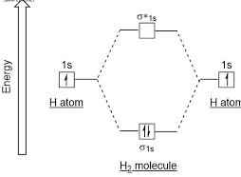


MOED of H₂ molecule
H₂ molecule electronic configuration: σ1s²<σ*1s⁰
In H₂ molecule BO is one means a single bond present between two H-atoms.
H₂ is having paired electron so H₂ is diamagnetic nature.
Bond order =

Slide 12
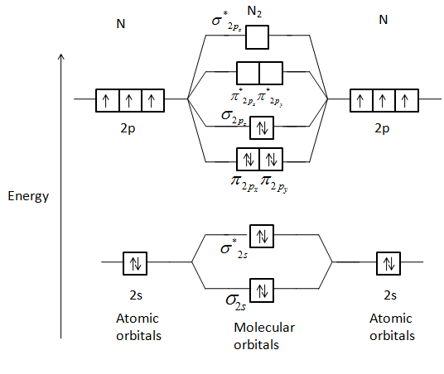
2. MOED of N₂ molecule

Slide 13

N₂ molecule electronic configuration:
σ1s² < σ*1s² < σ2s² < σ*2s² < π2px² = π2py² < σ2pz² < π*2px⁰ = π*2py⁰ < σ*2pz⁰
Bond order =
=
In N₂ molecule BO is three means a triple bond present between two N-atoms.
N₂ is not having unpaired electrons so N₂ is diamagnetic nature.

Slide 14
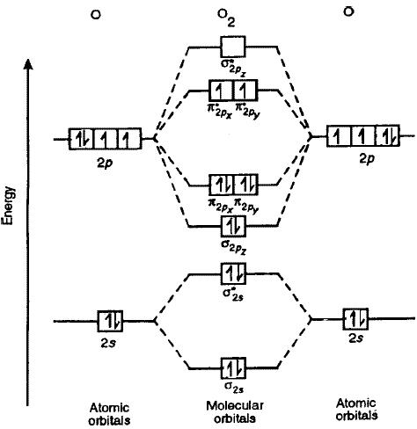
3. MOED of O₂ molecule

Slide 15

O₂ molecule electronic configuration:
1s² < σ*1s² < σ2s² < σ*2s² < σ2pz² < π2px² = π2py² < π*2px¹ = π*2py¹ < σ*2pz⁰
=
Bond order =
= 2
In O₂ molecule BO is two means a double bond present between two O-atoms.
O₂ is having two un paired electron so O₂ is paramagnetic nature.

Slide 16
SNO | Molecule/Ion | Total e-s | e- conf. | Bond order | No. of unpaired e-s | Magnetic nature
1 | O₂ | 16 | π*2px¹ = π*2py¹ < σ*2pz⁰ | 2 | 2 | para
2 | O₂⁺ | 15 | π*2px¹ = π*2py⁰ < σ*2pz⁰ | 2.5 | 1 | para
3 | O₂²⁺ | 14 | π*2px⁰ = π*2py⁰ < σ*2pz⁰ | 3 | 0 | dia
4 | O₂⁻ | 17 | π*2px² = π*2py¹ < σ*2pz⁰ | 1.5 | 1 | para
5 | O₂²⁻ | 18 | π*2px² = π*2py² < σ*2pz⁰ | 1 | 0 | dia

Slide 17
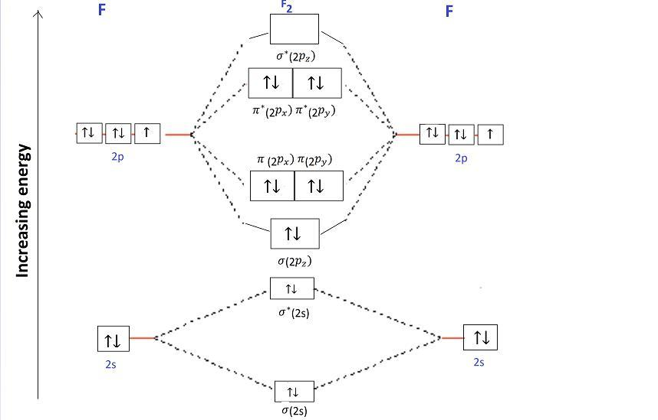
4. MOED of F₂ Molecule

Slide 18

F₂ molecule electronic configuration:
σ1s² < σ*1s² < σ2s² < σ*2s² < σ2pz² < π2px² = π2py² < π*2px² = π*2py² < σ*2pz⁰
Bond order =
=
In F₂ molecule BO is one means a single bond present between two F-atoms.
F₂ is having no un paired electron so F₂ is diamagnetic nature.

Slide 19
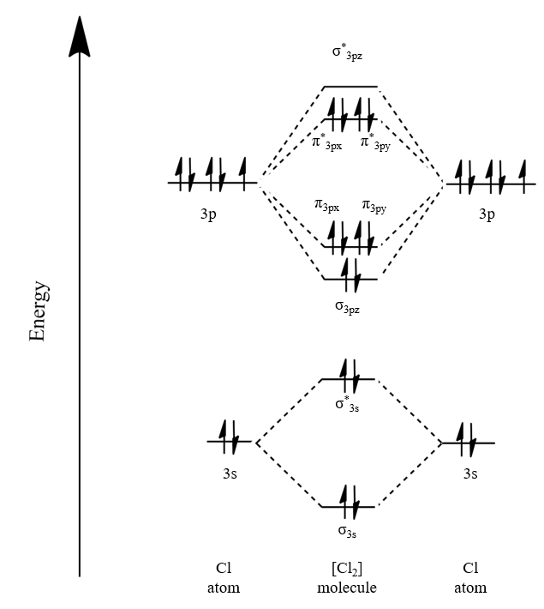
5. MOED of Cl₂ molecule

Slide 20

Cl₂ molecule electronic configuration:
σ1s² < σ*1s² < σ2s² < σ*2s² < σ2pz² < π2px² = π2py² < π*2px² = π*2py² < σ*2pz² <σ3s² < σ*3s² < σ3pz² < π3px² = π3py² < π*3px² = π*3py² < σ*3pz⁰
Bond order =
=
In Cl₂ molecule BO is one means a single bond present between two Cl-atoms.
Cl₂ is having no un paired electron so Cl₂ is diamagnetic nature.

Slide 21
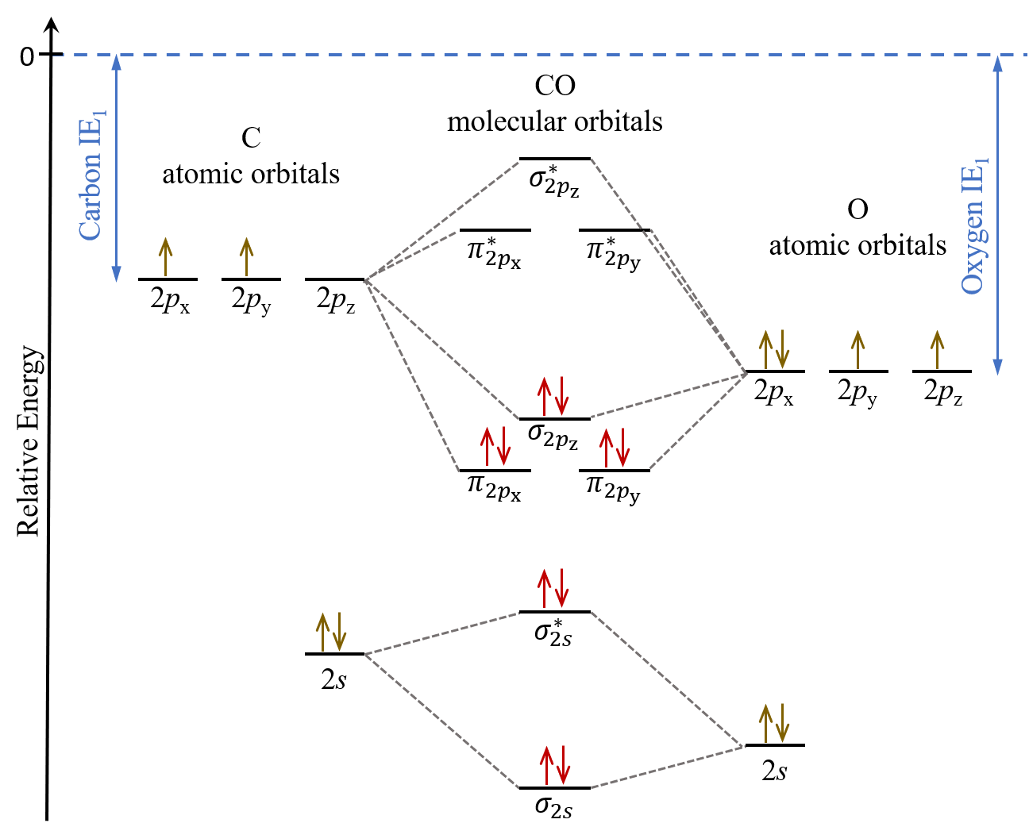
6. MOED of CO molecule

Slide 22
CO- Molecule electronic configuration:
σ1s² < σ*1s² < σ2s² < σ*2s² < σ2pz² < π2py² = π2px² < π*2py⁰ = π*2px⁰ < σ*2pz⁰
Bond order =
=
In CO molecule BO is three means a triple bond present between two C and O-atoms.
CO is not having unpaired electrons so CO is diamagnetic nature.

Slide 23
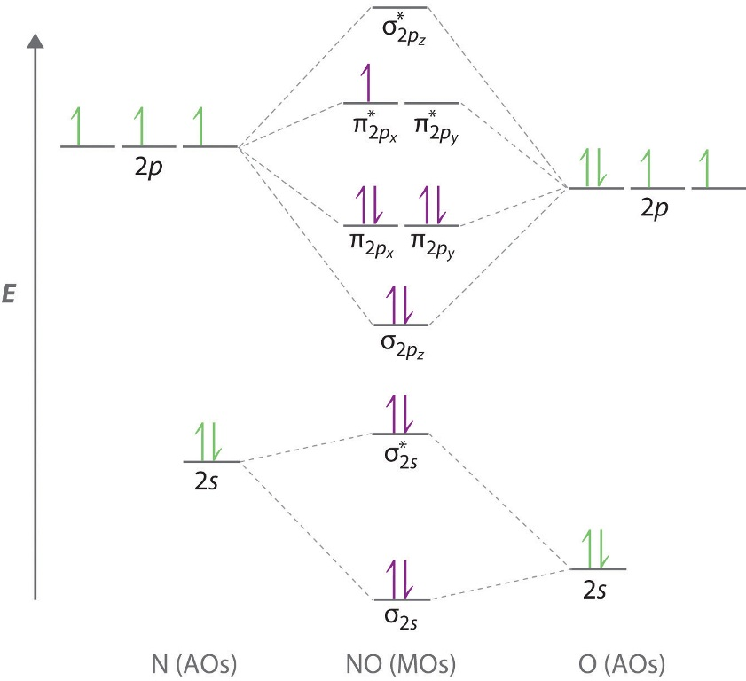
7. MOED of NO molecule

Slide 24


NO-Molecule electronic configuration:
σ1s² < σ*1s² < σ2s² < σ*2s² < σ2pz² < π2px² = π2py² < π*2px¹ = π*2py⁰ < σ*2pz⁰
Bond order =
=
In NO molecule BO is 2.5 means bond is intermediate to a triple bond and double.
NO is having one unpaired electron so NO is paramagnetic nature.

Slide 25
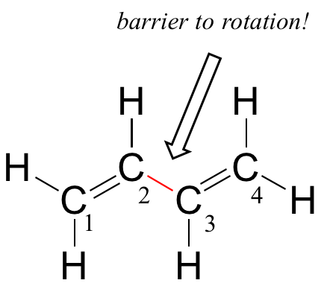
Π-Molecular Orbitals of 1,3-Butadiene
1,3-Butadiene contains two double bonds that are conjugated.
It is "built" from 4-sp² hybridized C atoms, each contributing a unhybride p-atomic orbital with one electron.
From valence orbital theory we might expect that the C₂-C₃ bond is a sigma bond, would be able to rotate freely.

Slide 26
However, it is observed that there is a barrier to rotation about the C₂-C₃ bond.
In addition, the C₂-C₃ bond is 148 pm, shorter than a typical carbon-carbon single bond (154 pm), longer than a typical double bond (134 pm).
MOT accounts for these observations with the concept of delocalized pi bonds.
The 4 unhybride p-atomic orbitals combine to form 4, π-Molecular orbitals.
Two of these - the bonding π-MO while two - the antibonding π-MO.

Slide 27
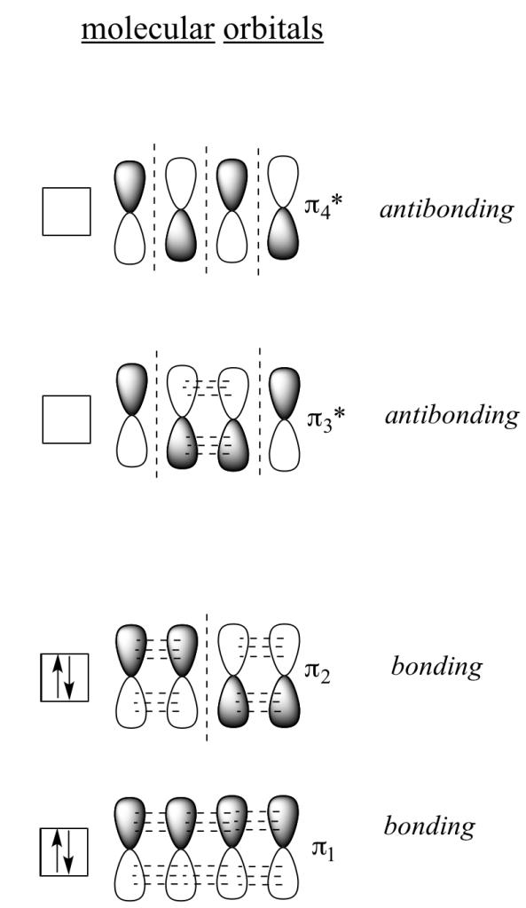
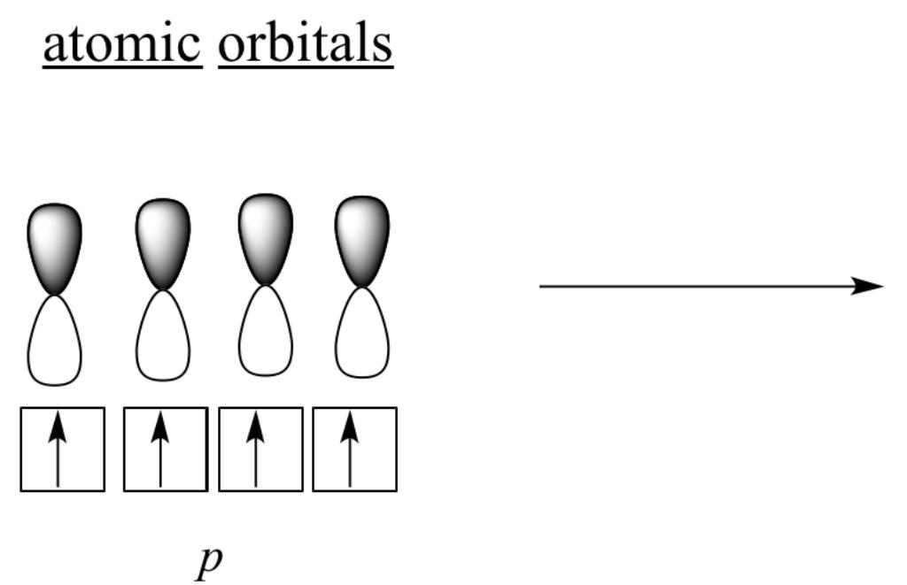
Π-Molecular Orbitals of 1, 3- Butadiene
HOMO (Highest occupied Molecular orbital = π2)
LUMO (Lowest unoccupied Molecular orbital = π*3)

Slide 28
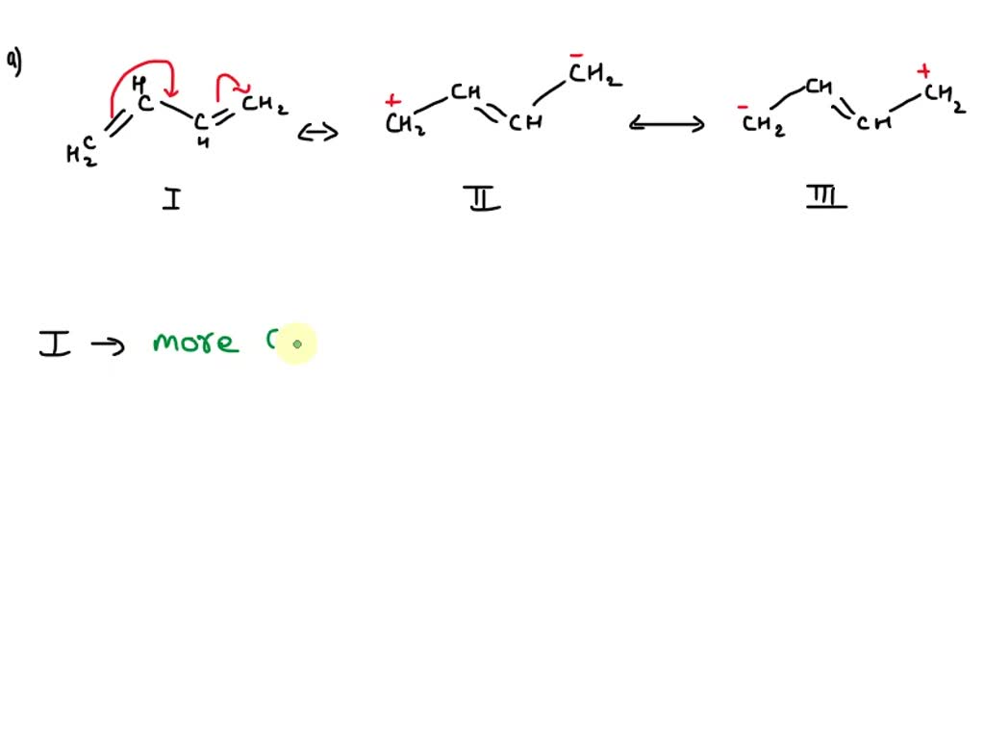
We now have 4-electrons to arrange, 1 from each of the original atomic p-orbitals.
These are all paired in the two stabilized π-bonding orbitals, π1 and π2.
The highest occupied molecular orbital or HOMO is π2 in 1,3-butadiene.
In contrast, the anti-bonding π*-orbitals contain no electrons.
The lowest unoccupied orbital or LUMO is π*3 in 1,3-butadiene.

Slide 29
Π-Molecular orbitals of benzene and Aromacity
Benzene (C6H6) the simplest aromatic hydro carbon. benzene has a planar hexagonal structure.
All the carbon atoms are sp²hybridized, and all the carbon-carbon bonds are equal in length.
Benzene has 3-degrees of unsaturation, making it a highly unsaturated hydrocarbon.
Whereas unsaturated hydrocarbons such as alkenes, alkynes and dienes readily undergo addition reactions, benzene does not.

Slide 30
Aromatic property that makes the π-bonds in benzene so stable.
Criteria for Aromaticity:
If the compound does meet all the following criteria, it is aromatic.
    The molecule is cyclic,
    The molecule is planar,
    The molecule is fully conjugated,
    The molecule has 4n+2 π electrons (n=0 or any positive integer).

Slide 31
Cyclic array of six p-orbitals of benzene ( one on each carbon) overlap to generate six molecular orbitals, three bonding and three antibonding.
According to Hackle's theory, a compound is particularly stable if all of its bonding molecular orbitals are filled with paired electrons. This gives a total of 4n+2 π-electrons.
Benzene has 6 π-e-s. Its first 2 π-e-s fill the lowest energy orbital, and it has 4 π-e-s remaining.
These 4 fill in the orbitals of the succeeding energy level.
Notice how all of its bonding orbitals are filled, but none of the anti-bonding orbitals have any electrons.
In Benzene HOMO are π2 and π3, LUMO are π*4, π*5.

Slide 32
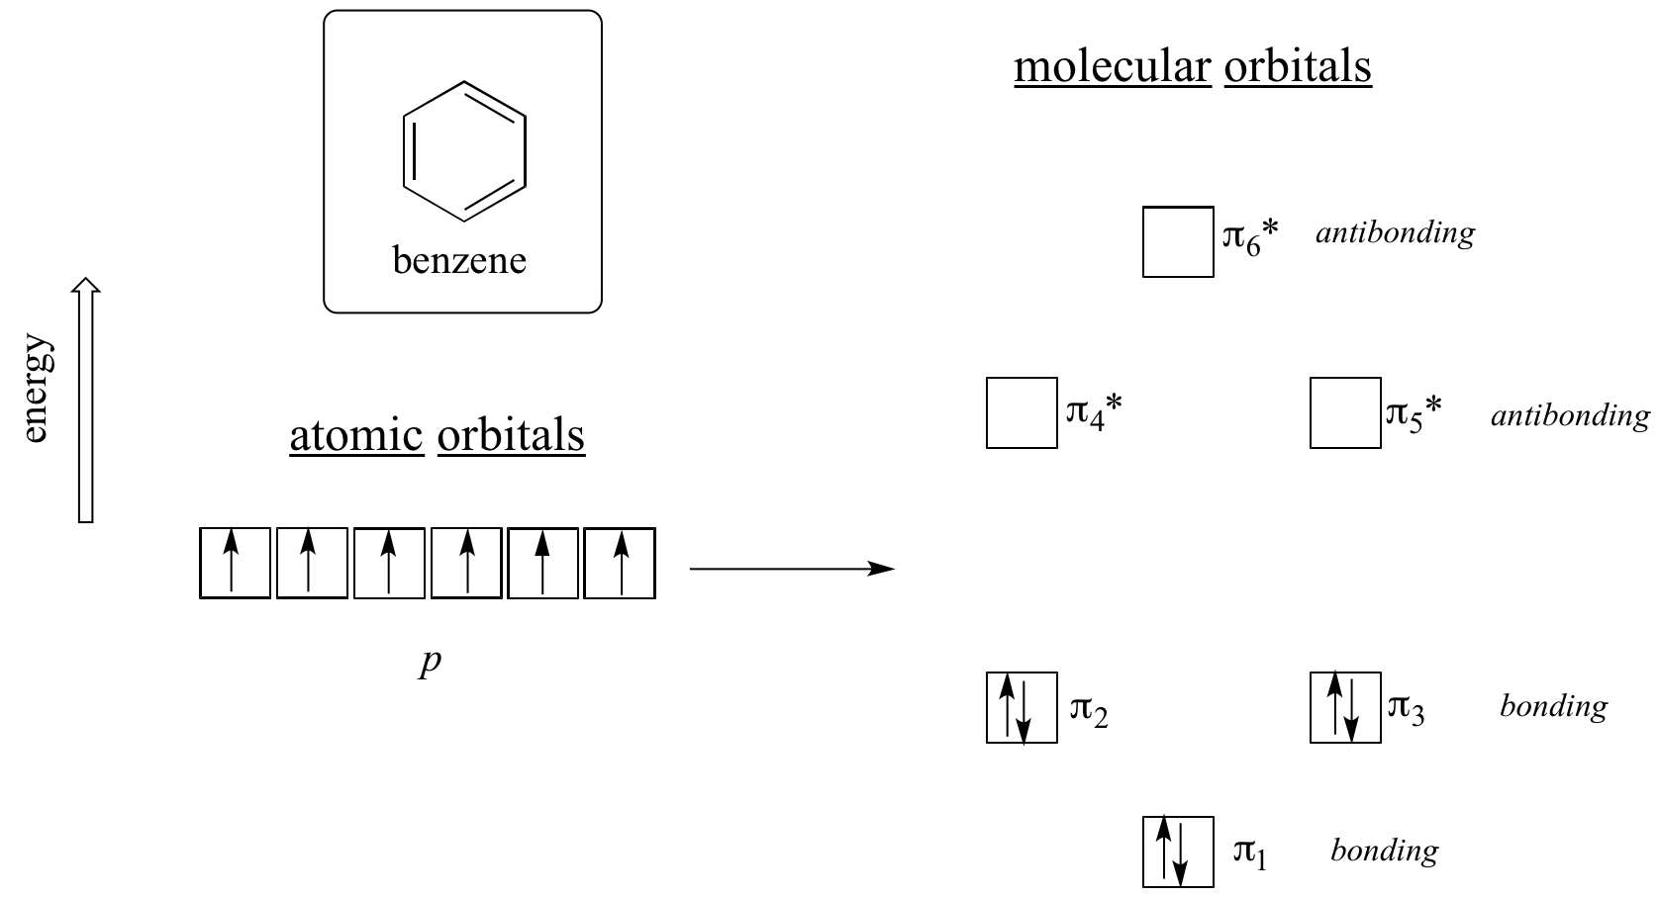

Slide 33
Crystal field theory
Crystal field theory (CFT) is a model developed by Bethe and Vlech.
It explained the bonding in complex compounds and the stability of these compounds
The following are the postulates of CFT :-
VBT (valence bond theory) considers the metal ligand bond to be covalent, whereas CFT considers these bonds to be ionic arising purely due to electrostatic interaction between the metal ions and the ligands.
Since these interactions are similar to this present in Crystals, hence the theory is called as crystal field theory.
If the ligand is anion (point charge) then the metal ion has to be a Cation and the force of attraction is due to opposite charges.
If the ligand is a neutral molecule (dipole) like H2O, NH3, etc then the negative end of their dipoles are attached towards the central metal ion.

Slide 34
It treated each ligand as a point of negative charge. The arrangement of these ligand around the central metal ion is such that the repulsion between the negative points (ligands) is minimum.
In all free transition metal ion, all the five d-orbitals have equal energies (i.e. they are degenerate). This degeneracy is maintained if the negative charges are present around the central metal ion in a spherical symmetrical field.
However if the negative field is due to the ligands which may be negative ion or polar molecules with their negative ends towards the central metal ion, then the field no longer remains symmetrical and the degeneracy is split.
The d-orbitals split into two parts (named as t2g and eg orbitals) depending on the number of ligands approaching the metal ion.

Slide 35
This splitting is affected by:
    The nature of the metal ion,
    The metal’s oxidation state (a higher oxidation state leads to a larger splitting),
    The arrangement of the ligands around the metal ion,
    The nature of the ligands surrounding the metal ion.
Spectrochemical series: I⁻ < Br⁻ < S²⁻< SCN ⁻ < Cl⁻ < F⁻ < OH⁻ < C₂O₄ ²⁻ < H₂O < NCS⁻ < EDTA⁴⁻ < pyridine < NH₃ < ethylenediamine < NO₂⁻ < CN⁻ < CO.
In the presence of weak field ligands splitting less electrons are not getting paired resulting in a paramagnetic complexes(High spin).
In the presence of strong field ligands splitting more electrons are getting paired resulting in a diamagnetic complexes(Low spin).

Slide 36
Crystal Field Stabilization Energy (CFSE) is defined as net gain in energy achieved by the complex for preferential filling of electrons into lower energy orbitals.
Calculation of CFSE in octahedral complexes
CFSE = -0.4 x t_{2g} electrons + 0.6 x e_{g} electrons
Calculation of CFSE in tetrahedral complexes
CFSE = -0.6 x e electrons + 0.4 x t₂ electrons

Slide 37
Crystal field splitting in Octahedral Complexes
In Octahedral complex ligands approach central metal ion along the axis, where d_{x}²_{-y}² and d_{z}² orbitals present.
In the case of an octahedral coordination compound having six ligands surrounding the metal atom/ion, we observe repulsion between the electrons in d orbitals and ligand electrons.
This repulsion is experienced more in the case of d_{x}²_{-y}² and d_{z}² orbitals as they point towards the axes along the direction of the ligand.
Hence, they have higher energy than average energy in the spherical crystal field.
On the other hand, d_{xy}, d_{yz,} and d_{xz} orbitals experience lower repulsions as they are directed between the axes.
Hence, these three orbitals have less energy than the average energy in the spherical crystal field.
Thus, the repulsions in octahedral coordination compound yield two energy levels:
      t_{2g}– set of three orbitals (d_{xy}, d_{yz} and d_{xz}) with lower energy
      e_{g} – set of two orbitals (d_{x}²_{-y}² and d_{z}²) with higher energy

Slide 38
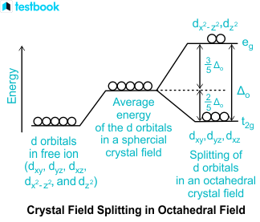

Slide 39
Let's consider the complexes
[Fe(H₂O)₆]Cl₃ (μ = 5.9 B.M.; 5 unpaired electrons),
K₃[Fe(CN)₆] (μ = 1.7 B.M.; 1 unpaired electron).
The free Fe³⁺ ion is a d₅ ion. The two complexes are 6-coordinate and octahedral.

Slide 40
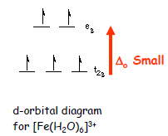
First let's look at the d-orbital diagram for [Fe(H₂O)₆]³⁺
HIGH SPIN
The first three electrons go into t₂g orbitals unpaired.
The 4th and 5th electrons must choose whether to pair up with electrons already in t_{2g} or to go into higher energy e_{g} orbitals. In this case, the splitting energy is less, so the 4th and 5th electrons go into the e_{g} orbitals.

Slide 41
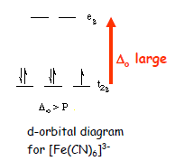
Now let's consider the [Fe(CN)₆]³⁻ ion
Again we have five d-electrons. However, there is only one unpaired electron, so the 4th and 5th electrons must pair with electrons already in t_{2g} orbitals.
This happens because the octahedral splitting is much greater in the hexacyanoferrate(III) ion than in the hexaaquoiron(III) ion. That is, the cyanide ligand causes a much greater d-orbital splitting than water does.
LOW SPIN: The first three e-s go into t_{2g} orbitals as before. The splitting is greater, so e-s to pair up in the t2g orbitals than to go into the eg orbitals.

Slide 42
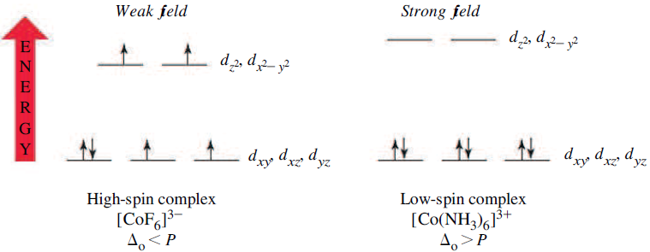

Slide 43
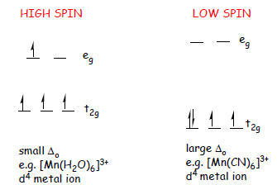

Slide 44
Crystal field splitting in Tetrahedral Complexes
Imagine a tetrahedral molecule inside a cube with metal ions in the center of the cube.
The ligands occupy the four alternate corners of the cube leaving the rest four corners empty.
The g-subscript should be omitted in tetrahedral complexes as these are never symmetrical.
In tetrahedral, the ligand approach is in between the axes. The two ‘e’ (d_{x2-y2} and d_{z2}) orbitals point to the center of the face of the cube while the three ‘t₂’ (d_{xy}, d_{yz} and d_{zx}) orbitals point to the center of the edges of the cube.
Thus, the t₂-orbitals are nearer to the direction of approach of the ligands than the e-orbitals.
So t₂-orbitals energy will increase and e-orbitals energy will decrease.

Slide 45
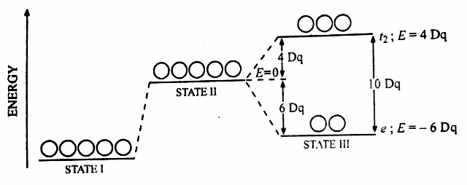

Slide 46
Magnetic properties of metal ligand complexes
Those which are attracted by magnetic field are termed as paramagnetic while others which are repelled by magnetic field are called diamagnetic.
Magnetic properties are determined by the number of unpaired electrons in the d orbitals of the metal ion.
Paramagnetic substances are those which contain unpaired electron spins and diamagnetic substances have paired electron spins.

Slide 47
Band Theory of Solids
In atoms and molecules we have seen that MOs are formed by the interaction of atomic orbitals.
In MOs, the BMO is separated from the AMBO by several eV of energy.
When 3-atomic orbitals from 3-atoms combine to form MOs, we get 3-MOs- one BMO, one ABMO and one NBMO.
When n-atomic orbitals from n-atoms interact, they give n-MOs.
When n-becomes very large, as in the case of a solid, there will be a large number of orbitals in a given range of energy.
This collection of orbitals or energy levels is referred to as band.
The study of band structure forms a central theme in the study of electronic structure of solids.

Slide 48
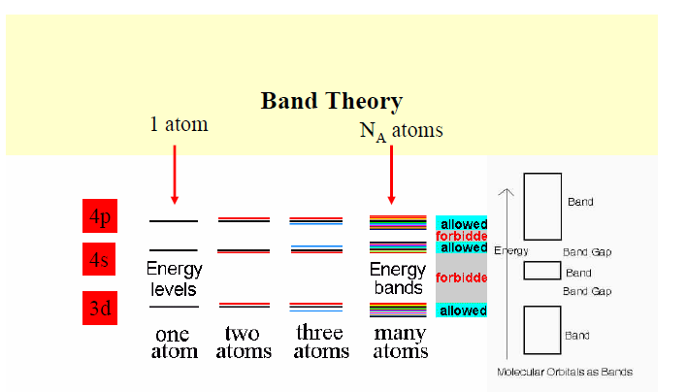
Band structure in Solids

Slide 49
Valence Band
The energy band which comprises of valence electrons energy levels is referred to as the valence band. This band is present below the conduction band. Further, the electrons of this band are loosely bound to the atom’s nucleus.
Conduction Band
This energy band comprises of free electrons energy level. In order to electrons to be free, external energy must apply in such a manner that the valence electrons push to the conduction band and become free.
Forbidden Band
This is basically the energy gap between the valence band and the conduction. We also refer to this as the forbidden gap. We determine the electrical conductivity of a solid from the forbidden gap. In addition, we can also determine the classification of the materials as conductors, semiconductors, and insulators.

Slide 50
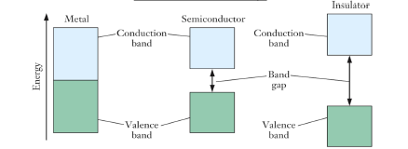
Conductors have small band gaps. A very small amount of energy is required to move electrons to the conduction band.
Insulators have large band gaps. A large amount of energy is required to move electrons to the conduction band.
Semiconductors have band gap intermediate of conductors and insulators.

Slide 51
Semiconductors
A semiconductor material is a substance that has a conductivity between that of an insulator and conductors.
Their resistance decreases as their temperature increases, which is behavior opposite to that of a conductor.
When the crystal lattice of a semiconductor is modified by the addition of foreign atoms, the electrical properties of the semiconductor change significantly.

Slide 52
Effect of doping on band structure of solids
In semiconductors the visible light photons do not have enough quantum energy to bridge the band gap and get the electrons up to an available energy level in the conduction band.
However, the doping of semiconductors has a much more dramatic effect on their electrical conductivity.
Doping a semiconductor introduces allowed micro energy states(Fermi energy levels)within the band gap.
In other words, electron donor impurities create states near the conduction band while electron acceptor impurities create states near the valence band.

Slide 53
Doping
Doping is the process of adding impurities to semiconductors to alter their electrical properties.
Normally Trivalent and Pentavalent elements are used to dope Silicon and Germanium.
n-type Semiconductor
When a pure semiconductor (silicon or germanium) is doped by pentavalent impurity (P, As, Sb, Bi), then four electrons out of five valence electrons bond with the four electrons of Ge or Si.
The fifth electron of the dopant is set free. Thus, the impurity atom donates a free electron for conduction in the lattice and is called a “Donar“.
Since the number of free electrons increases with the addition of an impurity, the negative charge carriers increase. Hence, it is called an n-type semiconductor.

Slide 54
p-type Semiconductor
When a pure semiconductor is doped with a trivalent impurity (B, Al, In, Ga), then the three valence electrons of the impurity bond with three of the four valence electrons of the semiconductor.
This leaves an absence of electron (hole) in the impurity. These impurity atoms which are ready to accept bonded electrons are called “Acceptors“.
With an increase in the number of impurities, holes (the positive charge carriers) are increased. Hence, it is called a p-type semiconductor.

Slide 55
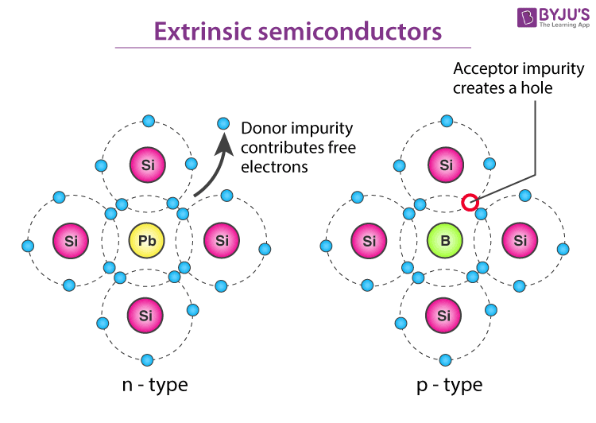

Slide 56
Bands for Doped Semiconductors
In n-type and p-type semiconductors extra levels added by the impurities.
In n-type material there are electron energy levels near the top of the band gap so that they can be easily excited into the conduction band.
In p-type material, extra holes in the band gap allow excitation of valence band electrons, leaving mobile holes in the valence band.

Slide 57
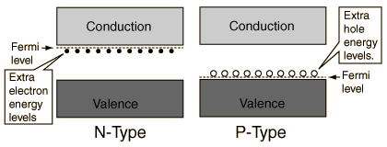

Slide 58
Short answer questions
Comparer atomic orbitals with molecular orbitals.
Differentiate BMOs with ABMOs.
Draw the MOED of 1, 3-Butadiene.
Calculate bond order for N2 molecule.
Define CFSE.
Compare strong field ligands with week field ligands.
Calculate CFSE for d6 complex.
Draw the structures of d-orbitals.
Arrange O_{2,} O₂⁻, O₂²⁻, O₂⁺, and O₂²⁺ increase order of bond order and predict magnetic nature.
What meaning by Spectrochemical series?
Define aromaticity.
What is the Huckels rule.
What is mean by Fermi energy level?
What are different types of doping?

Slide 59
Long answer questions
Write important postulations in MOT.
Draw MOED of N₂, O₂ and find bond order, magnetism.
Draw MOED of N₂, O₂ and find bond order, magnetism.
Discuss π-molecular orbitals of benzene with respect to aromaticity.
Explain crystal field theory.
Discuss crystal field splitting in Octahedral and tetrahedral complexes.
The paramagnetic momentums of [Fe(H₂O)₆]³ and [Fe(CN)₆]³⁻ are 5.9 B.M and 1.7 B.M. Why?

